Slide 1
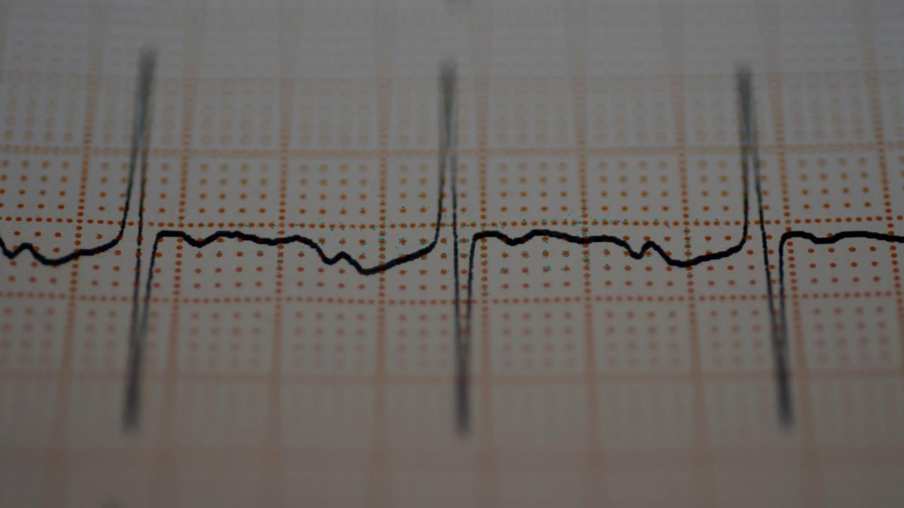

IDENTIFY CRITICAL PATIENTS PREDICTION MODEL
PREPARED BY:
Mohini Pujari Pranit Jadhav Sujitha L Darshan Bhatt
Harsh Chaudhary

Slide 2
BUSINESS PROBLEM | Accurately identifying critical patients So that health expert give more attention to the critical patient .
TECHNOLOGICAL PROBLEM | Data Quality and Consistency Model Generalization Across Diverse Populations Handling Missing Data and Imbalances Continuous Model Monitoring and Updating Scalability
IMPORTANCE | Reduced Healthcare Costs Medical Research Challenges in Healthcare Improved Patient Care
SUGGESTED SOLUTION | Patient-Centric Approach Resource Optimization and Alerts Integration with Electronic Health Records Clinical Validation and Real-World Testing

Slide 3
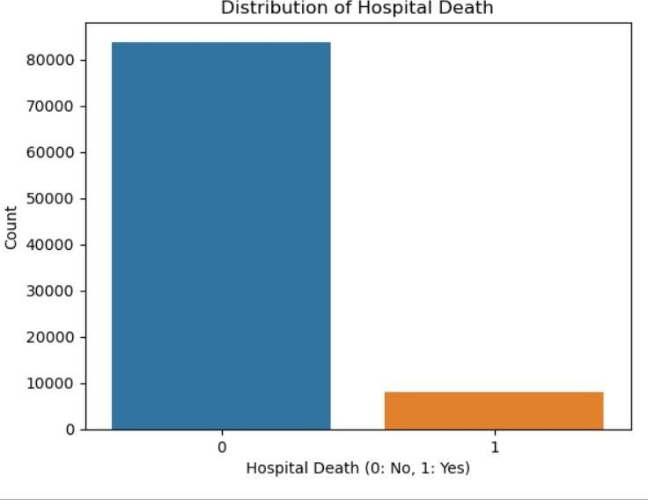
"Data Overview"
Dataset Dimensions:
Number of Rows: 91713
Number of Columns: 85
Column Types:
Such as patient ID's,
Reason for admission
Overall ICU stay and Unit stay
Previous health disease e.g. Diabetes
etc.
Target Distribution:
Positive Class (1): 8
Negative Class (0): 91 (Imbalance Ratio: 91:8)
Data Types:
Numeric columns : 78
Object: 7 columns

Slide 4
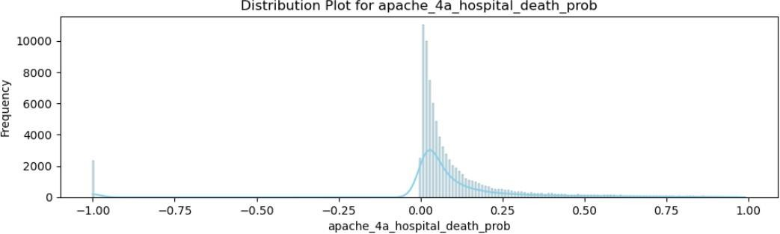
Data Preprocessing
Dropped Columns:
All ID columns dropped as they contained unique values.
Negative Values:
3 columns such as ICU days and probability of patients conditions columns has negative values
Missing values :
Potassium columns was contained 10% missing values.
Categorical Columns:
Applied binning to categorical columns, to reduce values and bring insignificant ones into single bin.
Skewness treatment
Data exhibits high skewness to the right and left
Yeo-Johnson Transformation:
Implemented Yeo-Johnson transformation to address the high skewness in the data.
To normalizes the data, bringing it into a range of -1 to 1.

Slide 5
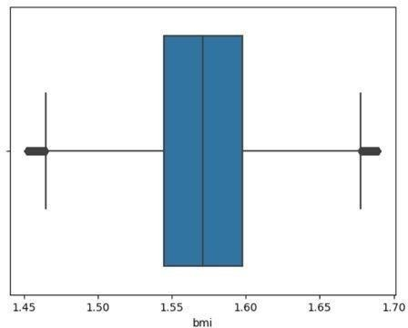
Outliers:
Outliers in hospital ICU data are expected due to variations individual health conditions.
Specific Example: BMI and Heart Rate BMI:
Extreme low or high BMI values can indicate critical health conditions
Such as malnutrition and obesity respectively
Heart Rate:
Extremely low indicates (bradycardia) or high heart rates indicates tachycardia these are indicative of critical conditions.

Slide 6
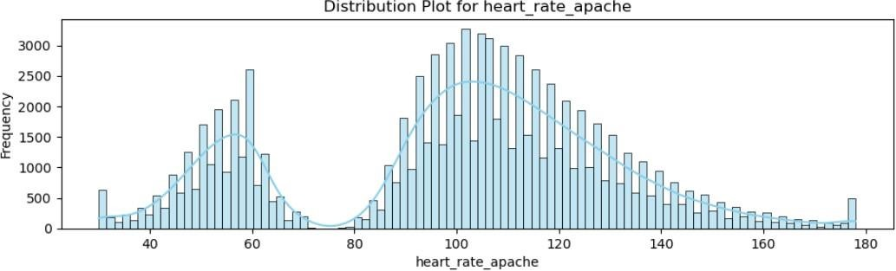
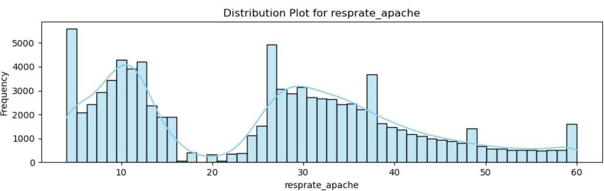
UNIVARIATE ANALYSIS
Distribution Plot:
Noticeable spikes are observed at the start and end of the distribution.
And depression at some points

Slide 7
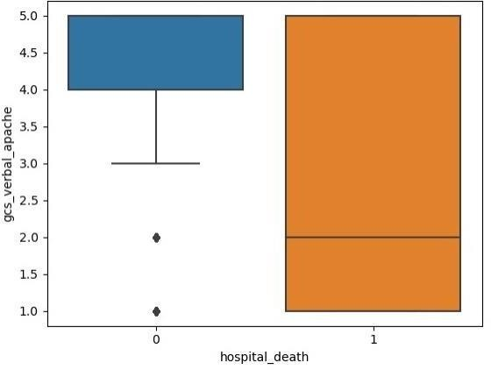
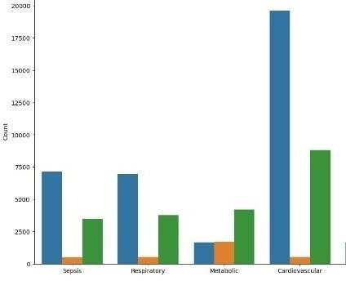
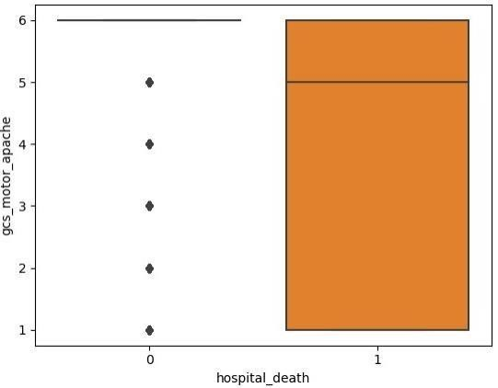
Demographic Insights:
Most patients in the dataset belong to the Caucasian ethnic group.
A significant portion of admissions is due to accidents and emergencies.
A considerable number of patients underwent surgery during their hospital stay.
Diabetes is more common in all age group

Slide 8
Data Preprocessing:
Scaled the data to ensure consistency in feature magnitudes.
Addressed class imbalance (91:8 ratio) using the SMOTE (Synthetic Minority Over-sampling Technique) technique, resulting in an 80:20 balanced ratio.
VIF Analysis:
After performing dummy encoding and transformation, the data shape is (91,713, 106).
Set a threshold at 5 and dropped 20 columns of invasive and non-invasive features that were highly correlated.
Threshold Adjustment Using ROC-AUC Curve :
Utilized the ROC-AUC curve to optimize the model's threshold.
Adjusted the threshold to enhance recall, as it is of utmost importance in identifying critical patients.

Slide 9
"Model Building Approach"
MODEL NAMES | ACCURACY | PRECISION | RECALL | F1 SCORE
Logistic Regression with adjusted Threshold | 0.71 | 0.20 | 0.83 | 0.32
Naïve Bayes with RFE | 0.70 | 0.18 | 0.75 | 0.29
Random Forest with adjusted Threshold | 0.80 | 0.26 | 0.80 | 0.39
Bagging Classifier with Decision Tree as base model | 0.93 | 0.66 | 0.26 | 0.37
Ada boost Model | 0.92 | 0.51 | 0.38 | 0.43
Recall, which is a critical metric for our specific goal of identifying critical patients accurately.
Recall: Capturing 83% of actual critical cases. This indicates the model's ability to identify a significant proportion of the positive instances.

Slide 10
FINAL MODEL
Logistic Regression model with an adjusted threshold.
Logistic Regr- ession with adjusted Threshold | ACCURACY | PRECISION | RECALL | F1 SCORE
Train data | 0.73 | 0.38 | 0.91 | 0.53
Test data | 0.71 | 0.20 | 0.83 | 0.53
While there is a small difference in accuracy between the two sets, it might not necessarily indicate a significant problem with overfitting.

Slide 11
Challenges
Model Performance Challenges:
Domain expertise : To understand outliers and distribution.
Low Precision
Highly correlated columns
Future steps :
Continuously collect and integrate relevant data to improve the model's performance.
Collaborate closely with healthcare professionals to incorporate domain expertise into the model.

Slide 12
THANK YOU

